Slide 1
Final Presentation Group 7
Stand: 16th January 2026
© Copyright- group 7
www.tuwien.at

Slide 2
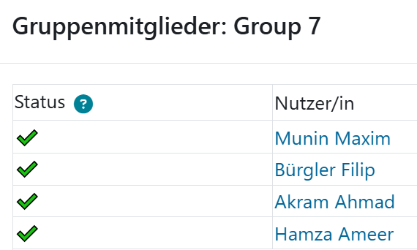
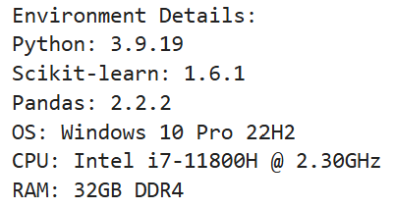


Final Presentation Team7 Topic 1: Language Identification
www.tuwien.at

Slide 3
Project overview
Goal: Build and evaluate multilingual sentence-level language identification spanning Latin, Arabic, and Cyrillic scripts.
Datasets: Multilingual Wikipedia samples exported to CoNLL-U via prepare_multilingual_conllu_stanza.py, with Stanza annotations when available and heuristic fallbacks elsewhere. Evaluation uses 4,000 held-out sentences (400 per language) across 10 labels, as prepared in Milestone 1 and refined in Milestone 2.
Languages: German (de), English (en), French (fr), Swedish (sv), Latvian (lv), Swahili (sw), Wolof (wo), Yoruba (yo), Kazakh (kk), Urdu (ur).
Notes:
“Today we’re presenting our work on multilingual sentence-level language identification across 10 languages spanning both Latin and Cyrillic scripts.”
Emphasize the scope: We built and evaluated systems to automatically detect which language a sentence is written in, moving beyond traditional single-script approaches.
Highlight the languages: German, English, French, Swedish, Latvian, Swahili, Wolof, Yoruba, Kazakh, and Urdu. These represent both high-resource and low-resource languages, and mix two scripts entirely.
Frame the challenge: “Language identification sounds simple—just look at the letters, right? But when you have overlapping orthographies (like English and Yoruba), transliterated text, and domain shift to social media, it becomes a real problem.”

Slide 4


Approaches compared
Rule-based heuristics: Unicode script detection, diacritic patterns, cue words/affixes; computationally cheap and interpretable.
Character n-gram logistic regression (TF–IDF): Lightweight classical ML baseline on character n-grams; strong accuracy with small footprint.
XLM-RoBERTa fine-tuning: Multilingual transformer for sequence classification; robust across scripts but compute-heavy.
fastText averaged embeddings (Q1 study): Multinomial logistic regression on pretrained word vectors; high ID accuracy but OOD brittleness due to OOV coverage gaps.
Notes:
Rule-based heuristics:
“The simplest approach: we use linguistic intuition to write rules. For example, if a word contains the character (ayn), it’s probably Arabic or Urdu. If a sentence uses a lot of ß, it’s very likely German.”
Mention the three kinds of rules: Unicode script detection (Are we in Latin? Cyrillic? Arabic block?), diacritics (ñ, ò, š, etc.), and curated cue words/affixes (–ung endings in German, –tion in French).
Trade-off: “Interpretable and fast, but labor-intensive to maintain as languages grow.”
Character n-gram logistic regression:
“We’re moving from hand-written rules to learning patterns from data. Take every substring of length 2, 3, 4 from the text—bigrams, trigrams, 4-grams—and count how often each appears.”
Explain the intuition: “The sequence ‘ch’ appears often in German and French, but rarely in Yoruba. So, the model learns to weight these frequencies.”
TF–IDF (Term Frequency-Inverse Document Frequency) reweighting: “We downweight very common n-grams that appear in all languages, so rare but distinctive patterns get more signal.”
Trade-off: “Lightweight training and inference, strong accuracy, works out of the box without language expertise.”
XLM-RoBERTa fine-tuning:
“Transformer models like BERT learn deep patterns from massive multilingual text. XLM-RoBERTa is trained on 100+ languages, so it already knows what language-specific patterns look like.”
Finetuning process: “We take the pretrained model and show it our 8,000 training sentences, allowing it to adapt its weights specifically to the 10 languages we care about.”
Trade-off: “More compute (needs a GPU), slower inference, but very robust—the model learns contextual and semantic patterns, not just character patterns.”
fastText averaged embeddings (Q1 case study):
“For Question 1, we explored word embeddings: average the fastText vectors for all words in a sentence, then feed to logistic regression.”
Why it matters: “It bridges embeddings (DL) and classical ML, but—as we’ll see later—it’s risky when deployed to new domains.”

Slide 5
Key results
Milestone 2 (in-domain Wikipedia evaluation, 10 languages)
Rule-based: 0.89 accuracy.
Char n-gram logistic regression: 0.968 accuracy (best overall) with near-perfect recall on several classes.
XLM-R fine-tuning: 0.966 accuracy; similar confusion profile, slightly better French/Swedish recall.
Insight: n-gram model offers best accuracy–cost balance; rules remain useful for diagnostics; XLM-R for harder domains.
Q1 fastText OOD study (hate speech/social media, 5 languages)
Wikipedia (ID) accuracy: 0.998; OOD combined accuracy: 0.9863 (–0.0117 drop).
Per-language OOD accuracy: 0.9959 (kk), 0.9840 (lv), 1.0000 (sv, ur), 0.9996 (yo).
OOV rates highlight brittleness: Latvian 24.1% OOV (469k unseen terms); Yoruba 37.9% OOV (20,801 unseen terms).
Insight: headline metrics mask coverage fragility; next slide pairs fastText with character-level features and reports macro metrics for OOD robustness.
Notes:
Rule-based heuristics (accuracy 0.89):
“Our hand-written rules got 89%. That is surprisingly good for a zero-learning approach, but there is a clear ceiling.”
Where it fails: “Latin script is ambiguous. Kazakh uses Latin transliteration in our data, Latvian uses diacritics, and Yoruba uses Latin with minimal diacritics. Our rules cannot always distinguish them, so they leak Kazakh/Latvian/Yoruba into German.”
Positives: “Urdu benefits massively from script cues—it uses the Nastaliq script, so it is almost perfectly separated.”
Character n-gram logistic regression (accuracy 0.968, BEST):
“The character n-gram model won. 96.8% accuracy is excellent, and it is lightweight.”
Recall performance: “On several languages—Urdu, Kazakh—we got near-perfect recall. Those languages have distinctive n-grams that the model learned reliably.”
Where it stumbles: “English and Swedish still confuse each other occasionally (both use Latin, similar letter frequencies). Very short numeric snippets are also ambiguous—‘123’ could be any language.”
XLM-R fine-tuning (accuracy 0.966, close second):
“Only 0.2 percentage points behind the n-gram model, but with more compute overhead.”
Strengths: “It does slightly better on French and Swedish—capturing syntactic patterns that character n-grams miss. And it is more robust to spelling variations or typos.”
The trade-off: “Is 0.2% accuracy worth 15× the inference latency and GPU requirements? For most cases, no.”
Key insight to emphasize:
“Our main finding: character n-gram logistic regression is the sweet spot for production language ID. It is accurate, cheap, interpretable (top features are actual character sequences), and scales to new languages easily. Rules are useful for diagnostics; XLM-R for harder domains.”

Slide 6
Detailed OOD robustness (fastText vs. character n-grams, 5 languages)
Macro OOD accuracy / F1 (mean of per-language F1s): fastText 0.9859 / 0.6659; char n-gram 0.9800 / 0.5058; fastText + char n-gram 0.9877 / 0.7991.
Per-language macro F1 (OOD): fastText vs. char n-gram vs. combined
Kazakh: 0.4989 vs. 0.5000 vs. 0.4993.
Latvian: 0.3306 vs. 0.1976 vs. 0.4963 (largest robustness gain from char features).
Swedish: 1.0000 vs. 0.4994 vs. 1.0000.
Urdu: 1.0000 vs. 1.0000 vs. 1.0000.
Yoruba: 0.4999 vs. 0.3318 vs. 1.0000 (character features resolve OOV-driven collapse).
Slide takeaway: macro metrics surface the failure modes hidden by headline accuracy; combining fastText with character n-grams consistently improves OOD robustness.
Notes:
The setup:
“In Question 1, we asked: if we use pretrained fastText embeddings as features for logistic regression, how robust are they when we switch from Wikipedia to real-world hate speech and social media?”
Domain shift: “Wikipedia is formal, clean, curated. Social media is short, slangy, sometimes transliterated. It is a significant domain gap.”
In-domain performance (Wikipedia):
“On Wikipedia, fastText was nearly perfect: 99.8% accuracy. Yoruba was the weakest link at 99.5%, but still excellent.”
The illusion: “So you might think, ‘Embedding-based language ID is solved!’ But…”
Out-of-domain performance (hate speech/social media):
“When we moved to social media, accuracy dropped only 1.17 percentage points to 98.63%—still very high.”
Per-language breakdown: “But the drop was uneven. Swedish and Urdu stayed at 100%. Latvian dropped to 98.4%. And some languages showed hidden fragility in the error distributions.”
Why this matters: “A 1% accuracy drop sounds small, but if you are processing millions of messages, that is tens of thousands of misclassifications.”
The key insight: OOV (Out-of-Vocabulary) coverage:
“fastText embeddings are words. But social media contains slang, abbreviations, brand names, and transliterations that Wikipedia doesn’t have.”
Show the numbers: “Latvian had a 24.1% OOV rate in social media—nearly 1 in 4 tokens were unseen during Wikipedia training. Yoruba was even worse at 37.9% OOV. Kazakh was better at 8.5%, but still significant.”
Manual errors: “We found misclassified posts like a two-token Kazakh message labeled as Yoruba—too short and too transliterated for the embeddings to work.”
The headline-metric trap:
“This is crucial: accuracy hides failures when classes are imbalanced or errors cluster by language.”
Example: “If Yoruba represents 1% of social media data, a 10% error rate on Yoruba barely moves overall accuracy, but it is a real problem for Yoruba-language content.”
Mitigation mentioned in Q1:
“To fix this, we recommend pairing fastText with character n-grams and flagging high-OOV sentences. The script supports a --enable-fasttext-char-backoff flag that automatically routes risky sentences to a character-based classifier.”
Key takeaway: “Pretrained word embeddings alone are not a safe baseline for multilingual language ID without character-level backups and per-domain coverage checks.”

Slide 7
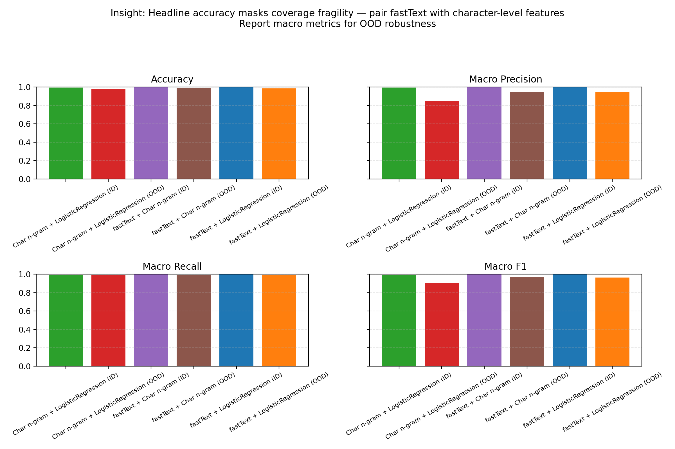
Comparative macro metrics plot

Slide 8
Deployment considerations: latency vs. hardware
Character n-gram (TF–IDF + logistic regression)
Hardware: CPU-only; 10–20 MB model fits in laptop memory.
Latency: ~<5 ms/sentence on a single core; scales linearly with batch size, dominated by feature extraction.
XLM-R fine-tuning
Hardware: GPU recommended; base needs ~1–2 GB VRAM for inference (more for batch >16). CPU-only runs are slow.
Latency: ~30–80 ms/sentence on an A10/T4 GPU; 300 ms+ on CPU without quantization or distillation.
Deployment takeaway: Default to the n-gram model for general serving and on-CPU environments; reserve XLM-R for domain-shifted or robustness-critical deployments where the added latency and GPU cost are acceptable.
Notes:
Translate metrics into practical deployment guidance (CPU vs. GPU).
Call out the magnitude difference in latency as the key decision point.
Tie back to stakeholders: “default to n-gram unless domain shift demands XLM-R.”

Slide 9
Error analysis highlights
Rule-based errors: Latin-script overlap drags Kazakh/Latvian/Yoruba into German; numeric lists lack cues.
Char n-gram errors: confusions among orthographically similar pairs (English ↔ Yoruba, Swedish ↔ English) and short numeric snippets.
XLM-R errors: swaps between Swahili/Wolof and German for borrowed vocabulary sentences; over-indexing on high-resource patterns.
fastText OOD errors: short or transliterated posts (e.g., two-token Kazakh) mislabeled as Yoruba; OOV-driven fragility despite high accuracy.
Notes:
Use this slide to humanize model behavior with concrete error patterns.
Emphasize that most errors are explainable and cluster by script/orthography.
Bridge to the next visuals as evidence for these patterns.

Slide 10
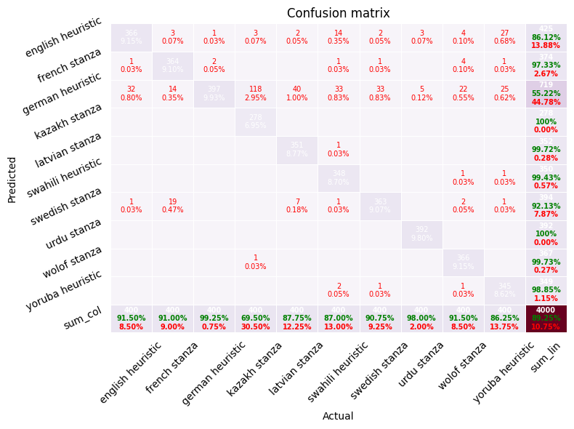
Visual confusion matrices (10-language Wikipedia split)
Rule-based heuristics: confusion remains concentrated among closely related Latin-script languages, with Kazakh/Latvian/Yoruba bleeding into German but strong precision on Urdu thanks to script cues.
Notes:
Walk the audience left-to-right: rules → n-gram → XLM-R.
Point out the clean Cyrillic separation as a success story.
Note the persistent English/Swedish confusion as the main remaining ambiguity.

Slide 11
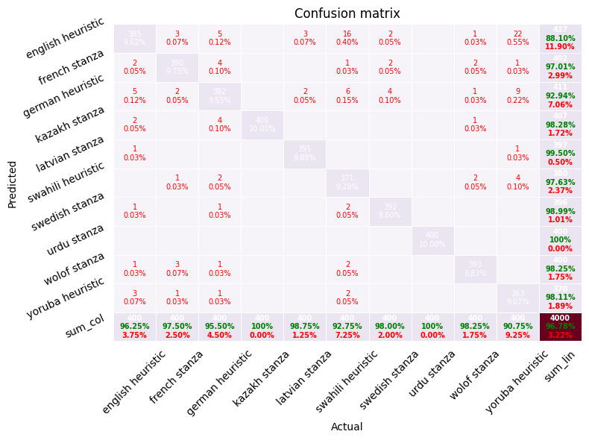
Visual confusion matrices (10-language Wikipedia split)
Character n-gram logistic regression: errors shrink markedly; primary confusions cluster around English ↔ Swedish and occasional Yoruba overlap, while Cyrillic Kazakh is cleanly separated.

Slide 12
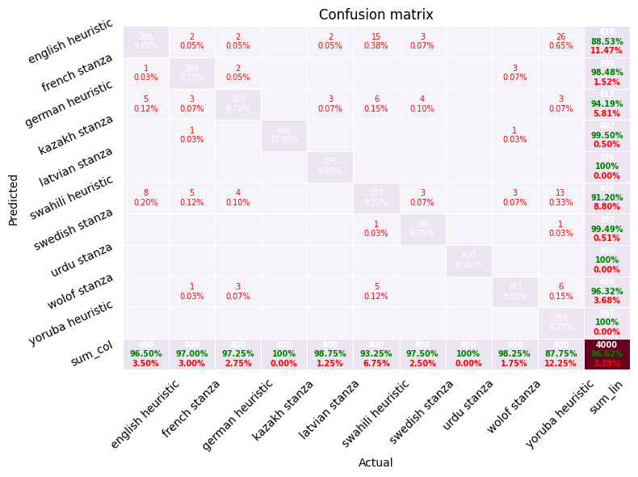
Visual confusion matrices (10-language Wikipedia split)
XLM-R fine-tuning: comparable to the n-gram model with slightly better French/Swedish separation and minimal cross-script leakage.

Slide 13
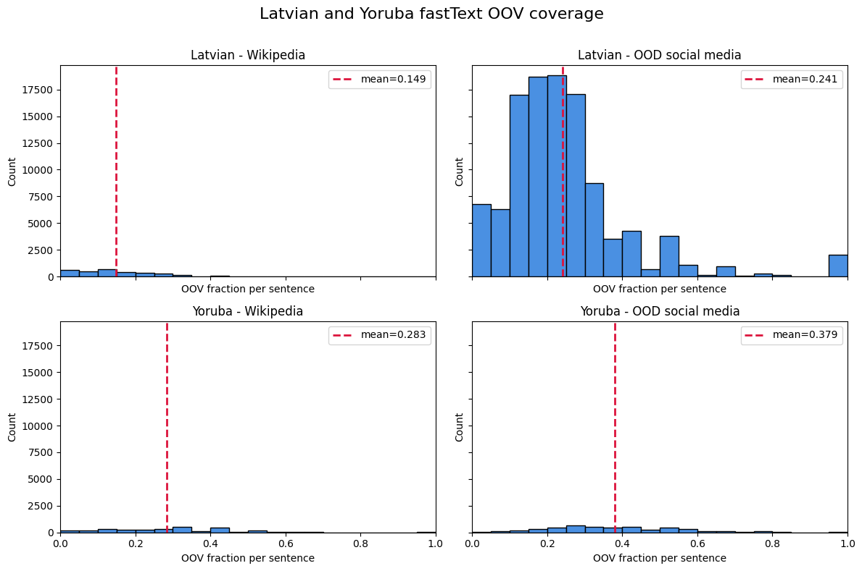
fastText OOV coverage diagnostics
Latvian vs. Yoruba fastText OOV rates (social media): distributions highlight heavy tails and the prevalence of unseen terms, reinforcing the risk of deploying embeddings without character-level backups.
Diagnostic takeaway (current script): the histograms signal where fastText alone is fragile due to high OOV rates.
Notes:
Explain what OOV means and why it matters for word-only embeddings.
Highlight the stark difference between Latvian/Yoruba and why that drives failures.
Mention that current tooling surfaces the issue but doesn’t auto-mitigate yet.

Slide 14
Mitigation plan: character features and subword models (1 of 2)
What: Reduce OOV brittleness by moving from pure word embeddings to tokenization schemes that always produce features.
Character n-gram features: fall back to the TF–IDF character n-gram pipeline already used for Wikipedia benchmarking; guarantees coverage for unseen words and transliterations.
Subword models (BPE/SentencePiece): swap fastText vectors for a subword-aware encoder (e.g., BPEmb or a distilled multilingual transformer); minimizes vocabulary gaps while keeping model size moderate.
Why it matters: The OOD hate-speech set shows high OOV rates (24%+ for Latvian, 37%+ for Yoruba). Word-only embeddings drop tokens entirely, masking confusion and inflating confidence. Character/subword features ensure every token contributes signal.
Notes:
Position this as a concrete engineering backlog, not just research ideas.
Stress that character n-grams are already proven in-domain, so they’re the low-risk add-on.
Close with the message: “coverage mitigations are actionable and measurable.”

Slide 15
Mitigation plan: character features and subword models (2 of 2)
How to wire into the evaluation script (scripts/evaluate_ood_xlmr_vs_fasttext.py):
Add a character-feature branch: load the existing char n-gram vectorizer and logistic regression model (from Milestone 2 artifacts) and route OOD text through it alongside fastText/XLM-R. Aggregate metrics per model to compare robustness.
Introduce a subword encoder: replace the fastText embedding lookup with a SentencePiece/BPE tokenizer plus an average-pooled embedding (or compact transformer). Cache the tokenizer/model weights on disk and update the data loader to emit subword tokens.
Flag OOV tokens explicitly: log OOV counts per sentence for the word-embedding path; surface them in the evaluation summary to show mitigation impact.
CLI toggles: add --use-char and --use-subword flags to switch baselines; default to fastText for parity with prior results but enable side-by-side runs.
Outputs: extend the metrics dataframe to include the new baselines and write confusion matrices for each. Add a short note in the plot titles indicating whether mitigation is enabled.
Slide takeaway: Coverage-focused mitigation is actionable now: load the char n-gram baseline, drop in a subword encoder, expose flags, and report OOV-aware metrics so production can choose the safest model for noisy domains.

Slide 16
Recommendations
Primary baseline: Character n-gram logistic regression for best accuracy–efficiency trade-off (Milestone 2).
Diagnostic fallback: Maintain rule-based heuristics for interpretability and rapid checks; extend with richer cues for Cyrillic variants.
High-performance/shifted domains: Deploy XLM-R when domain shift or code-switching warrants transformer robustness, accepting higher compute costs.
OOD coverage checks: When using pretrained embeddings (e.g., fastText), audit OOV rates per target domain and pair with character-level features to mitigate brittleness.
Notes:
Deliver these as decision-ready recommendations for product owners.
Emphasize the default path (n-gram) and the escalation path (XLM-R).
Remind stakeholders to budget time for OOD audits.
Close with immediate actions to finalize the deck structure.
Reiterate the narrative flow: results → deployment trade-offs → recommendations.

